Slide 1


Slide 2
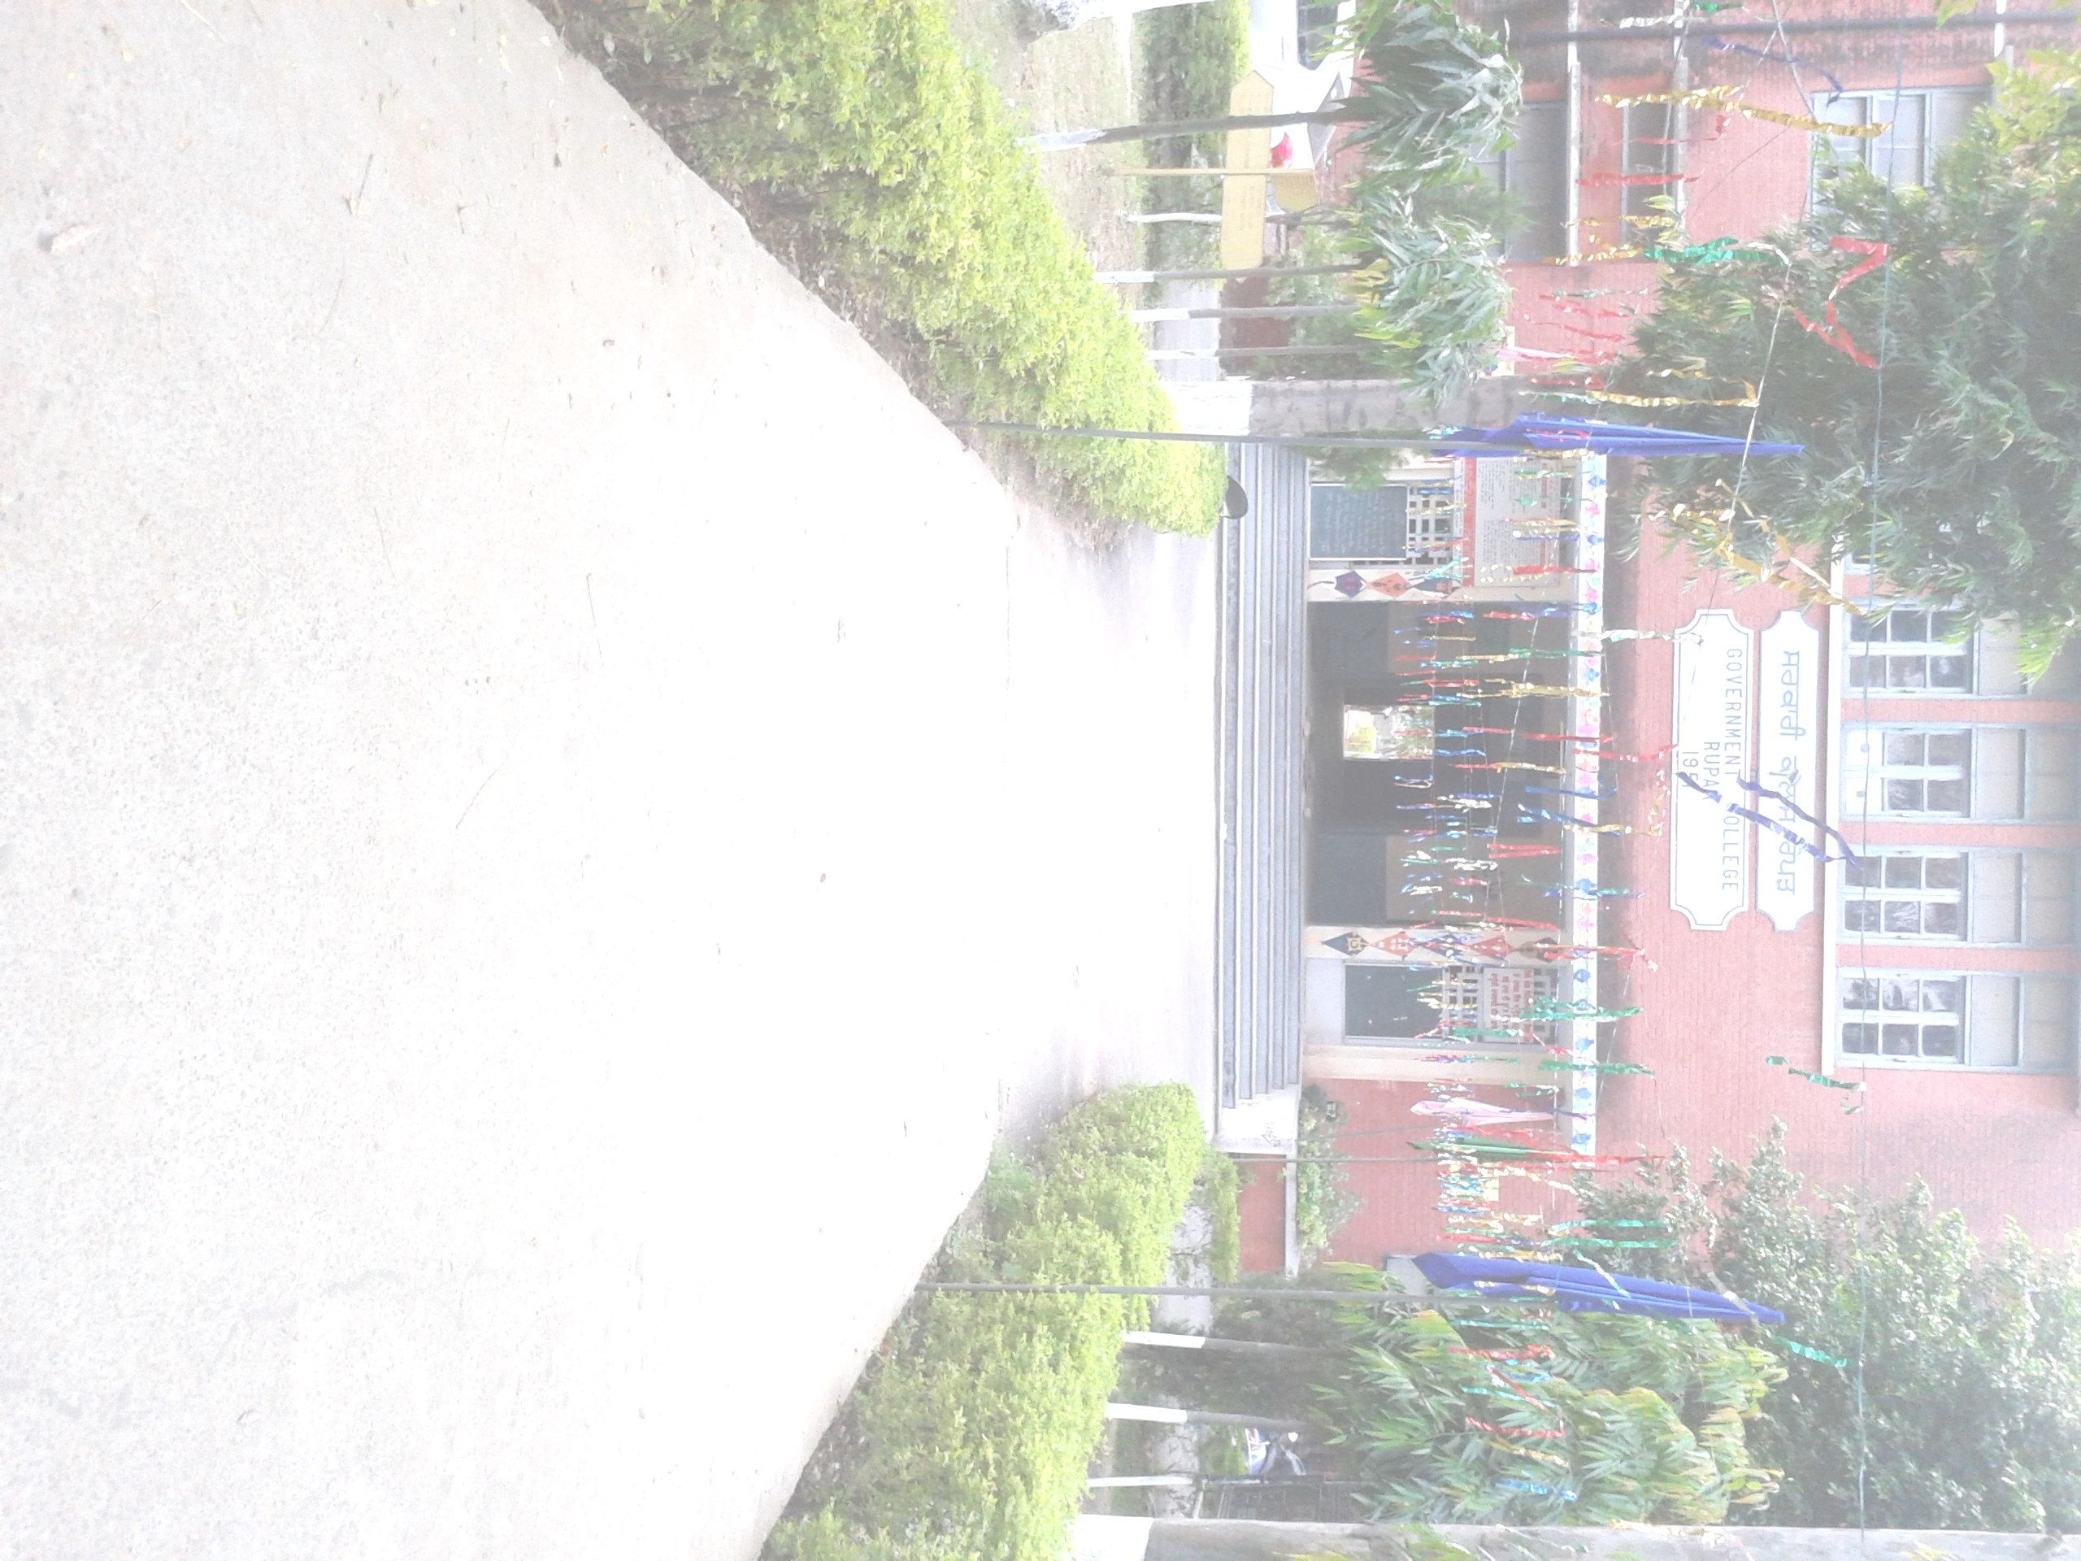

POST GRADUATE DEPARTMENT OF ENGLISH, GOVERNMENT COLLEGE, ROPAR

Slide 3
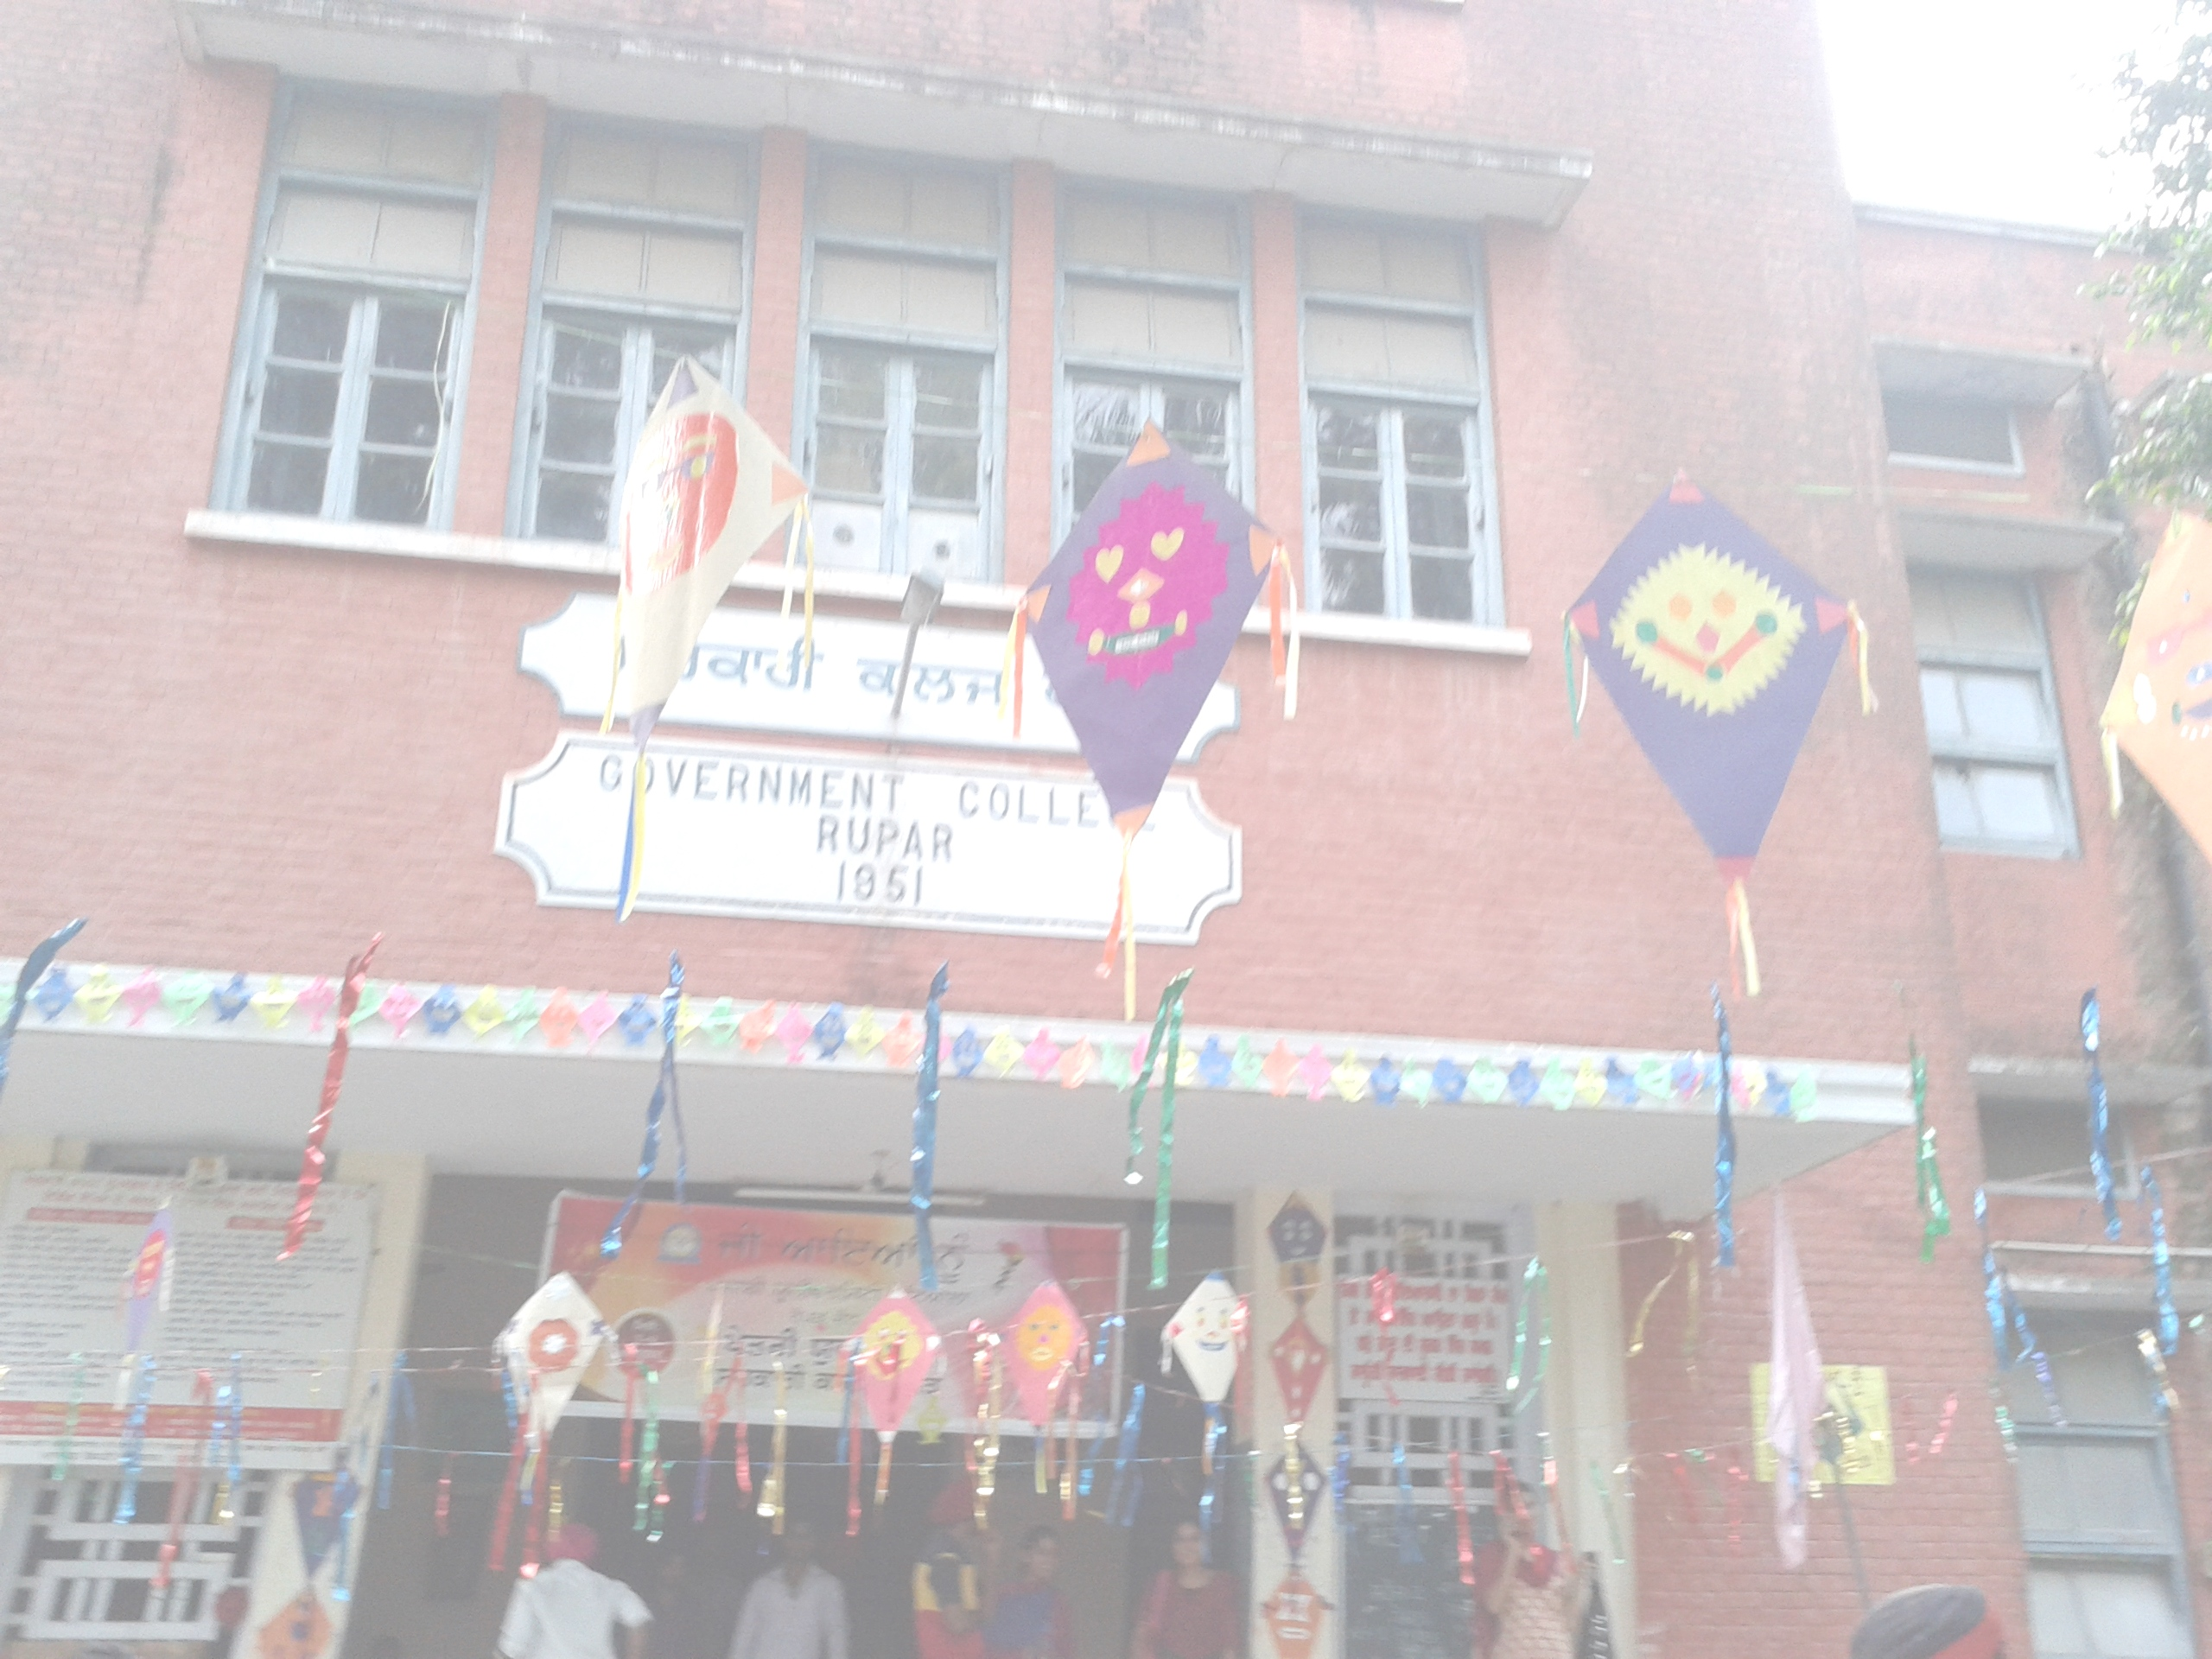
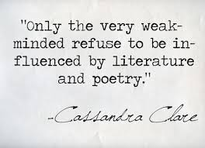
Welcomes the NAAC peer team with warm affection and beauty of literature.

Slide 4
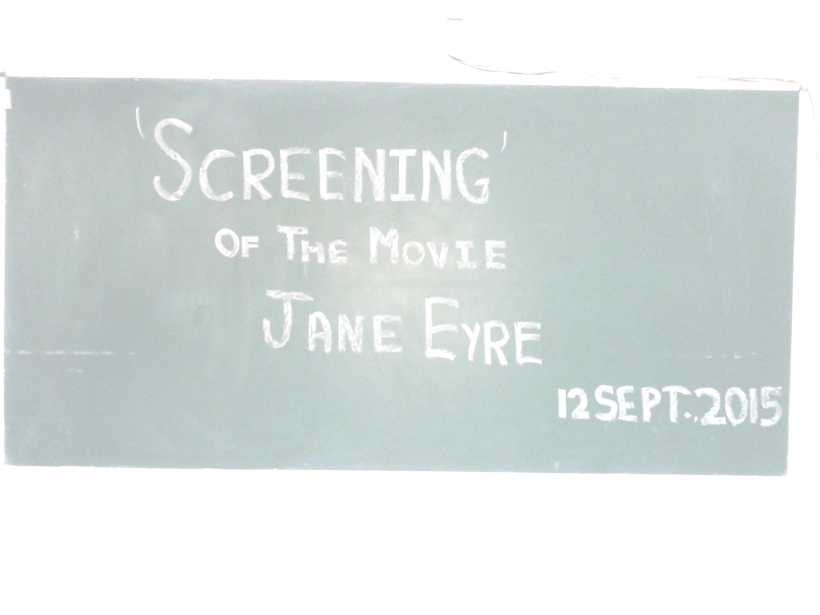
CONTENTS
ABOUT DEPARTMENT
FACULTY
VISION OF THE DEPARTMENT
PEDAGOGY
NUMBER OF STUDENTS
STUDENTS PERFORMANCE EVALUATION
ASSESSMENT DIVISION
RESEARCH EXPERIENCE
FEATURES OF THE DEPARTMENT
STUDENTS’ SUCCESS RATE
EXTRA CURRICULAR ACTIVITIES
MISSION

Slide 5

The Post Graduate Department of English was established during the inception of college in 1945.
It is a pioneer department of the college and caters to the needs of the whole college academically and professionally. Post graduation began in 1950 and since then it has been successful in instilling the love for literature in students. The department also has an add on course in Spoken English which began in the year 2012. Many literary activities are also conducted by The Literary Society of the department.

Slide 6
FACULTY
NAME | POSITION | EXPERIENCE | QUALIFICATION | THRUST AREA | CLASSES
PROF. ANIL KUMAR | HEAD | 31 YEARS | M.A., M.PHIL | INDIAN WRITING IN ENGLISH | B.A. III, M.A. I, M.A. II
PROF. GURPREET KAUR | ASSISTANT PROFESSOR | 20 YEARS | M.A., B.Ed. | AMERICAN LITERATURE | B.A. II, M.A. I, M.A. II, B.A. IIII
PROF. MANJINDER KAUR | ASSISTANT PROFESSOR | 8 YEARS | M.A., M.PHIL | AMERICAN DRAMA | B.COM II, B.A. I, B.A. II, B.A. III
PROF. SUKHWINDER KAUR | ASSISTANT PROFESSOR | 16 YEARS | M.A.,M.PHIL, B.Ed., PGTCE, PGDJMC | INDIAN WRITING IN ENGLISH | B.A. I, B.A. II, B.A. II(ELECTIVE), M.A. II
PROF. DINESH KUMARI |  | 5 YEARS | M.A. | BRITISH LITERATURE | B.A. II, B.Sc. II, B.A. III, B.A. I

Slide 7
FACULTY CONTD.
NAME | POSITION | EXPERIENCE | QUALIFICATION | THRUST AREA | CLASSES
PROF. SANDEEP KUMARI |  | 4 YEARS | M.A. | AMERICAN LITERATURE | B.A. I, B.A. II, B.COM I,
PROF. SUKHWINDER SINGH |  | 3 YEARS | M.A. | INDIAN WRITING IN ENGLISH | B.A. I, B.A. III, B.COM II, B. Sc. II
PROF. NATASHA KALRA |  | 1 YEAR | M.A., M.PHIL | LINGUISTICS | B.COM I, B.Sc. II, B.A. I, B.A. III(ELECTIVE)

Slide 8
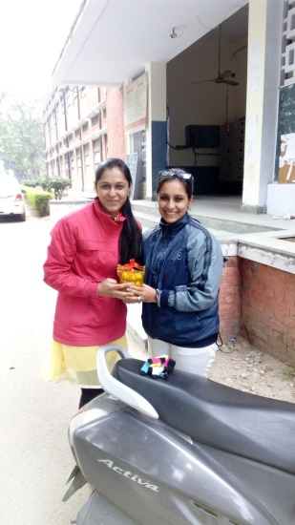
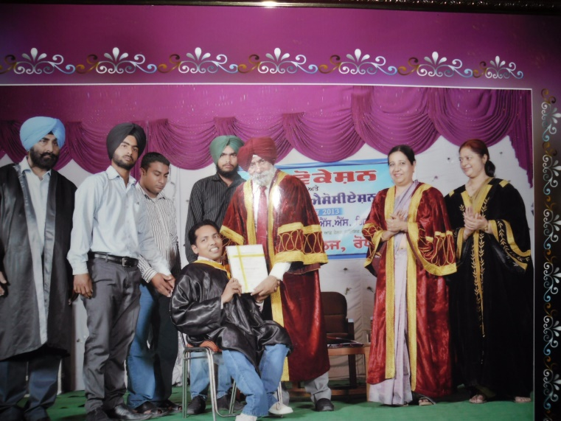
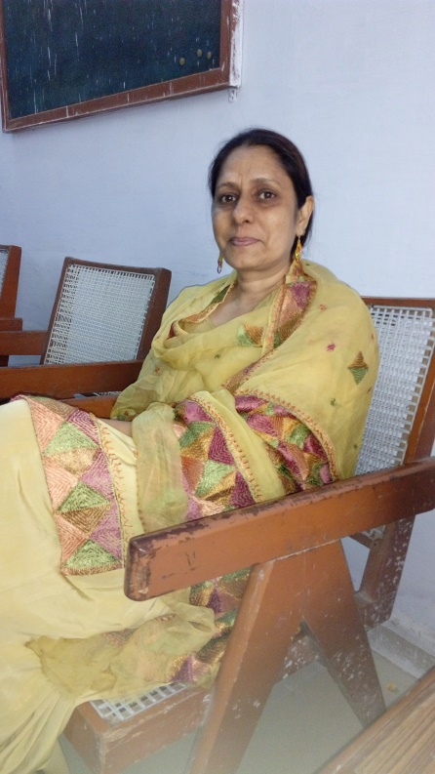
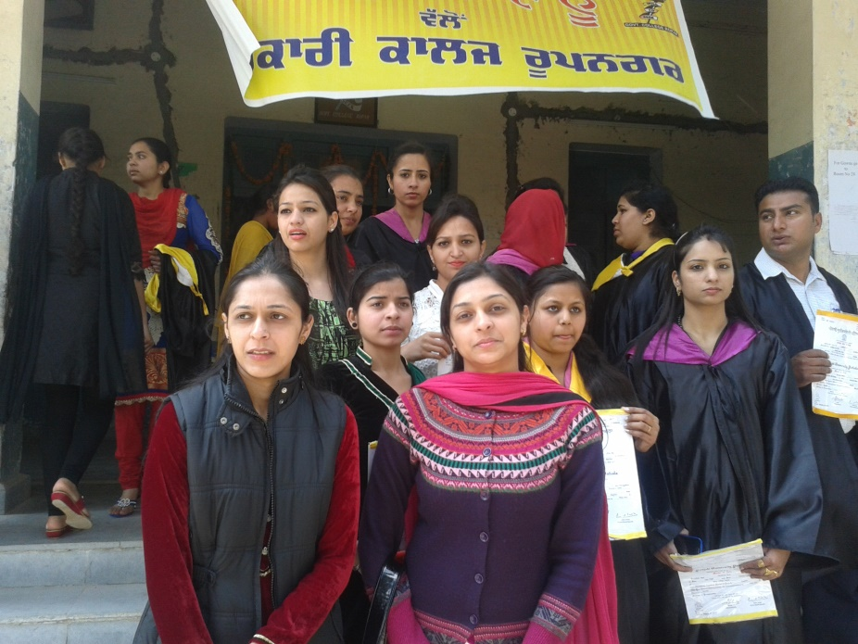
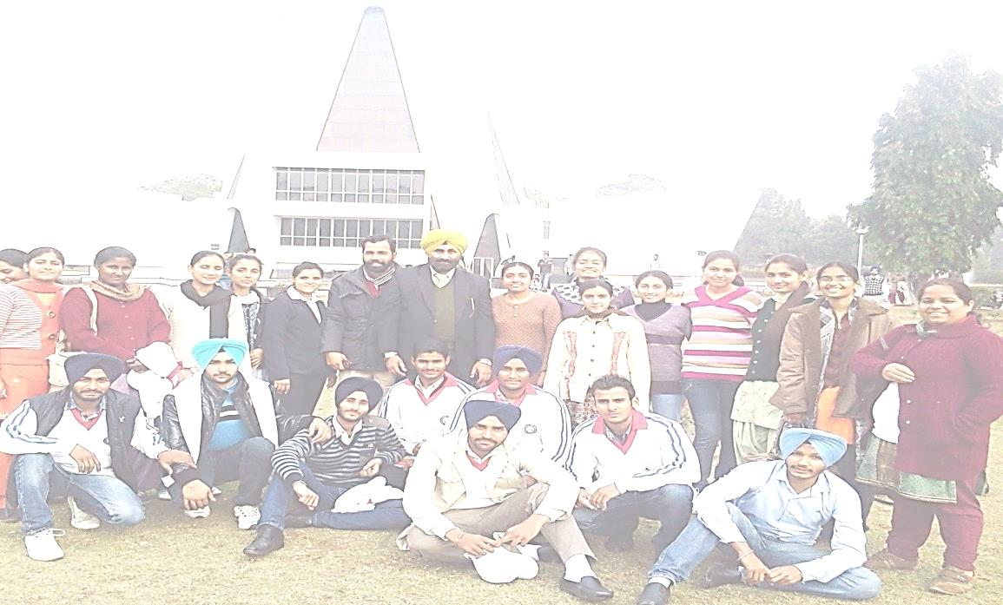
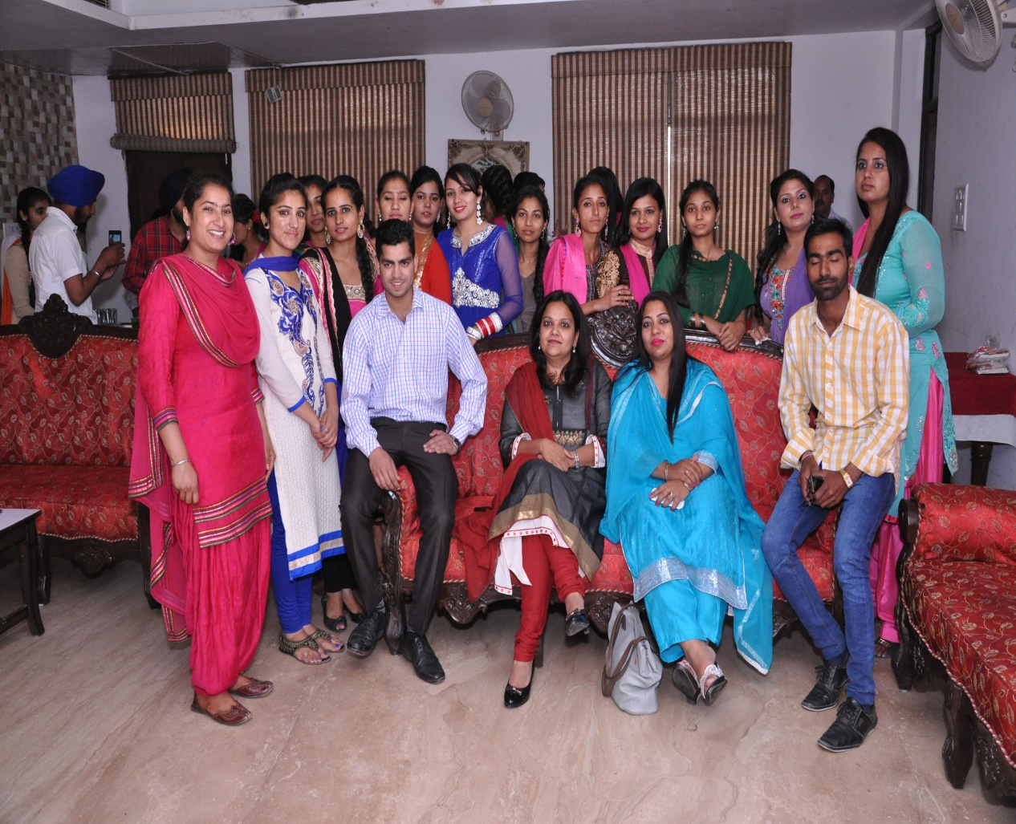
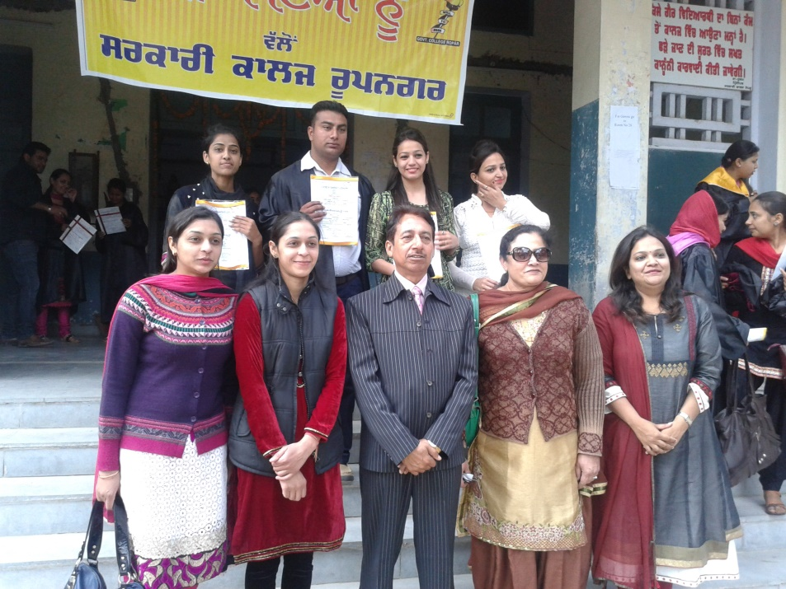

Slide 9
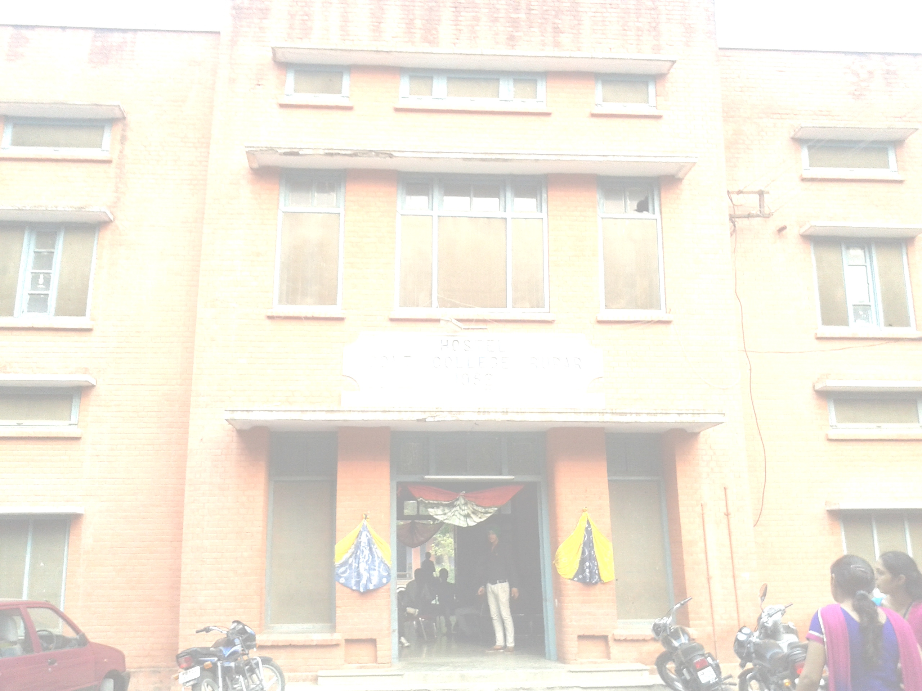
VISION OF THE DEPARTMENT
THE VISION OF THE DEPARTMENT IS TO PROMOTE EXCELLENCE IN HIGHER EDUCATION AND RESEARCH. THE DEPARTMENT AIMS AT PROVIDING JUST AND QUALITY EDUCATION SO AS TO PRODUCE BETTER CITIZENS WHO ARE ALSO CAPABLE OF MAKING A BETTER SOCIETY.

Slide 10

PEDAGOGY
CLASSROOM LECTURES
GROUP DISCUSSIONS
SEMINARS
WORKSHOPS
POWERPOINT PRESENTATIONS
CHARTS/ MODELS
MOVIE SCREENING ON RESPECTIVE NOVELS

Slide 11
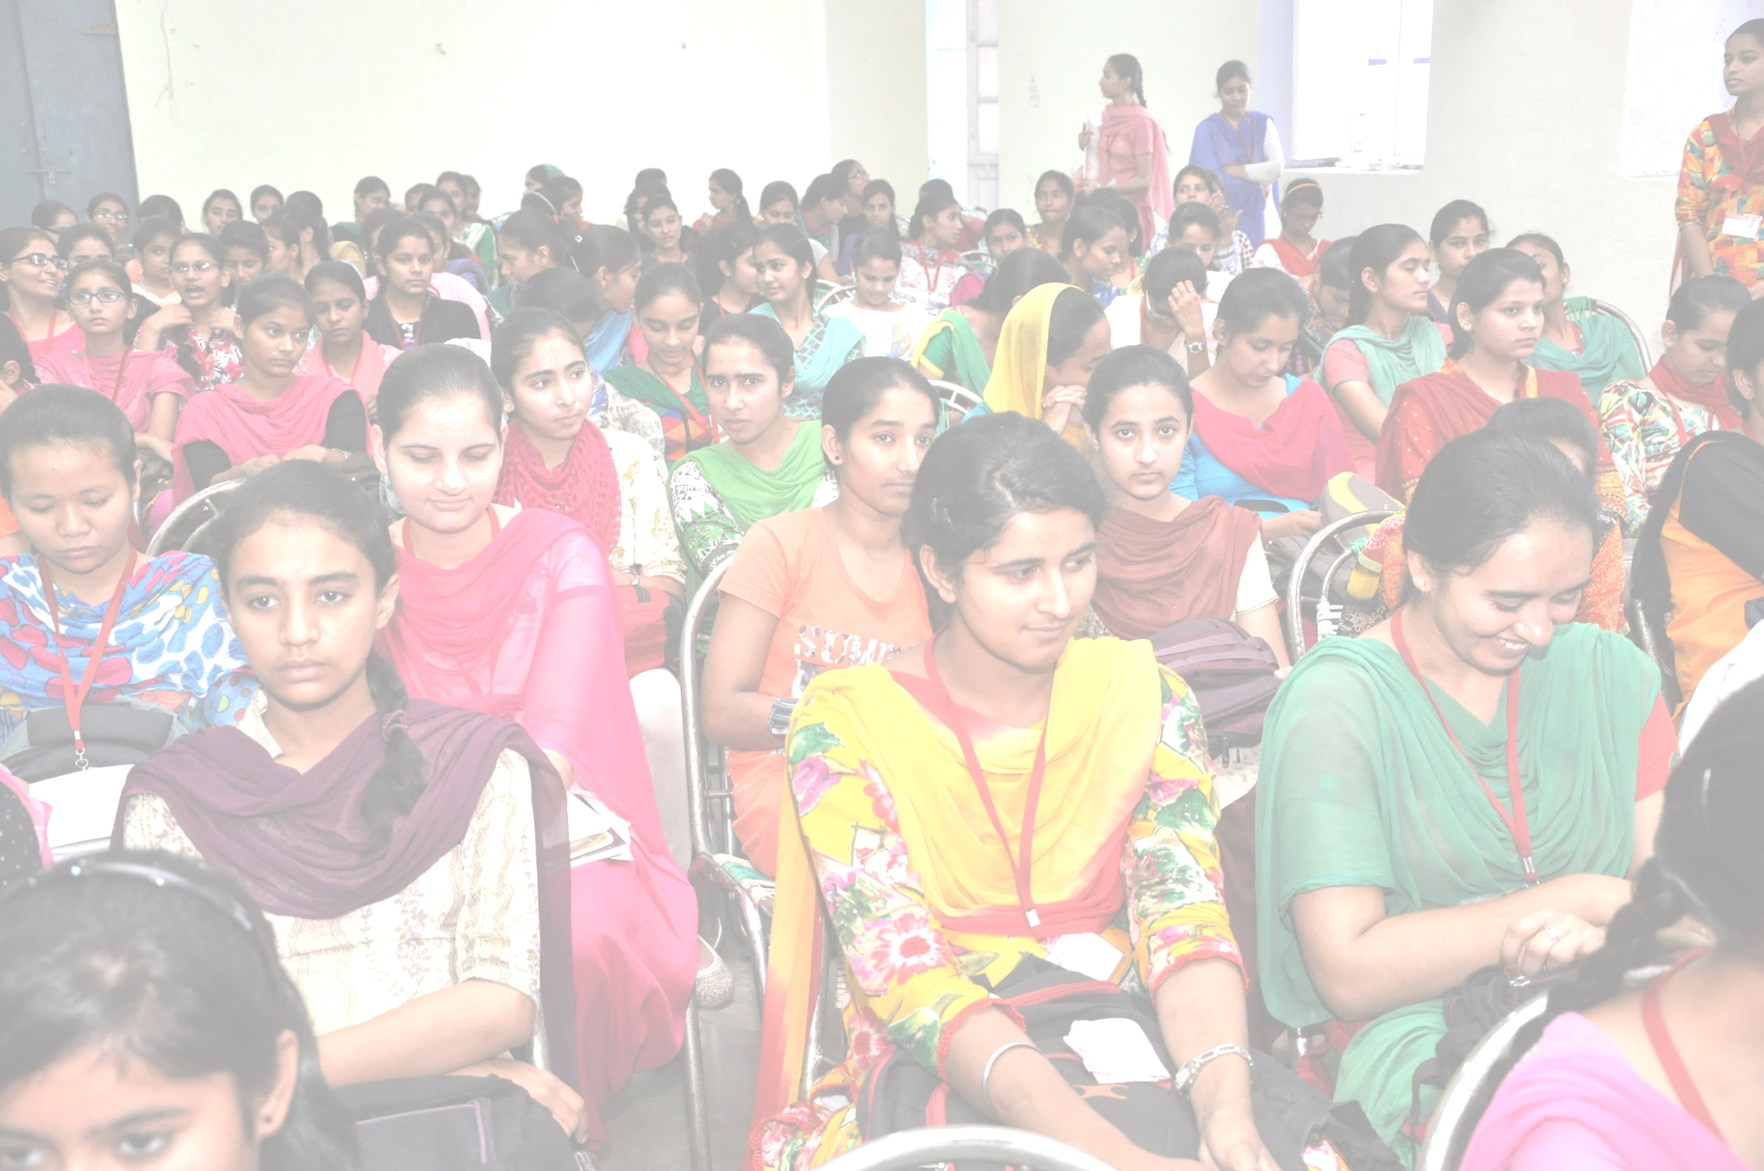
STRENGTH OF STUDENTS
(UNDER GRADUATION)
CLASSES | TOTAL NUMBER
B.A. I | 533
B.A. I (LITERATURE) | 20
B.A. II | 402
B.A. II(LITERATURE) | 14
B.A. III | 281
B.A. III (LITERATURE) | 8
B.COM I | 117
B.COM II | 111

Slide 12
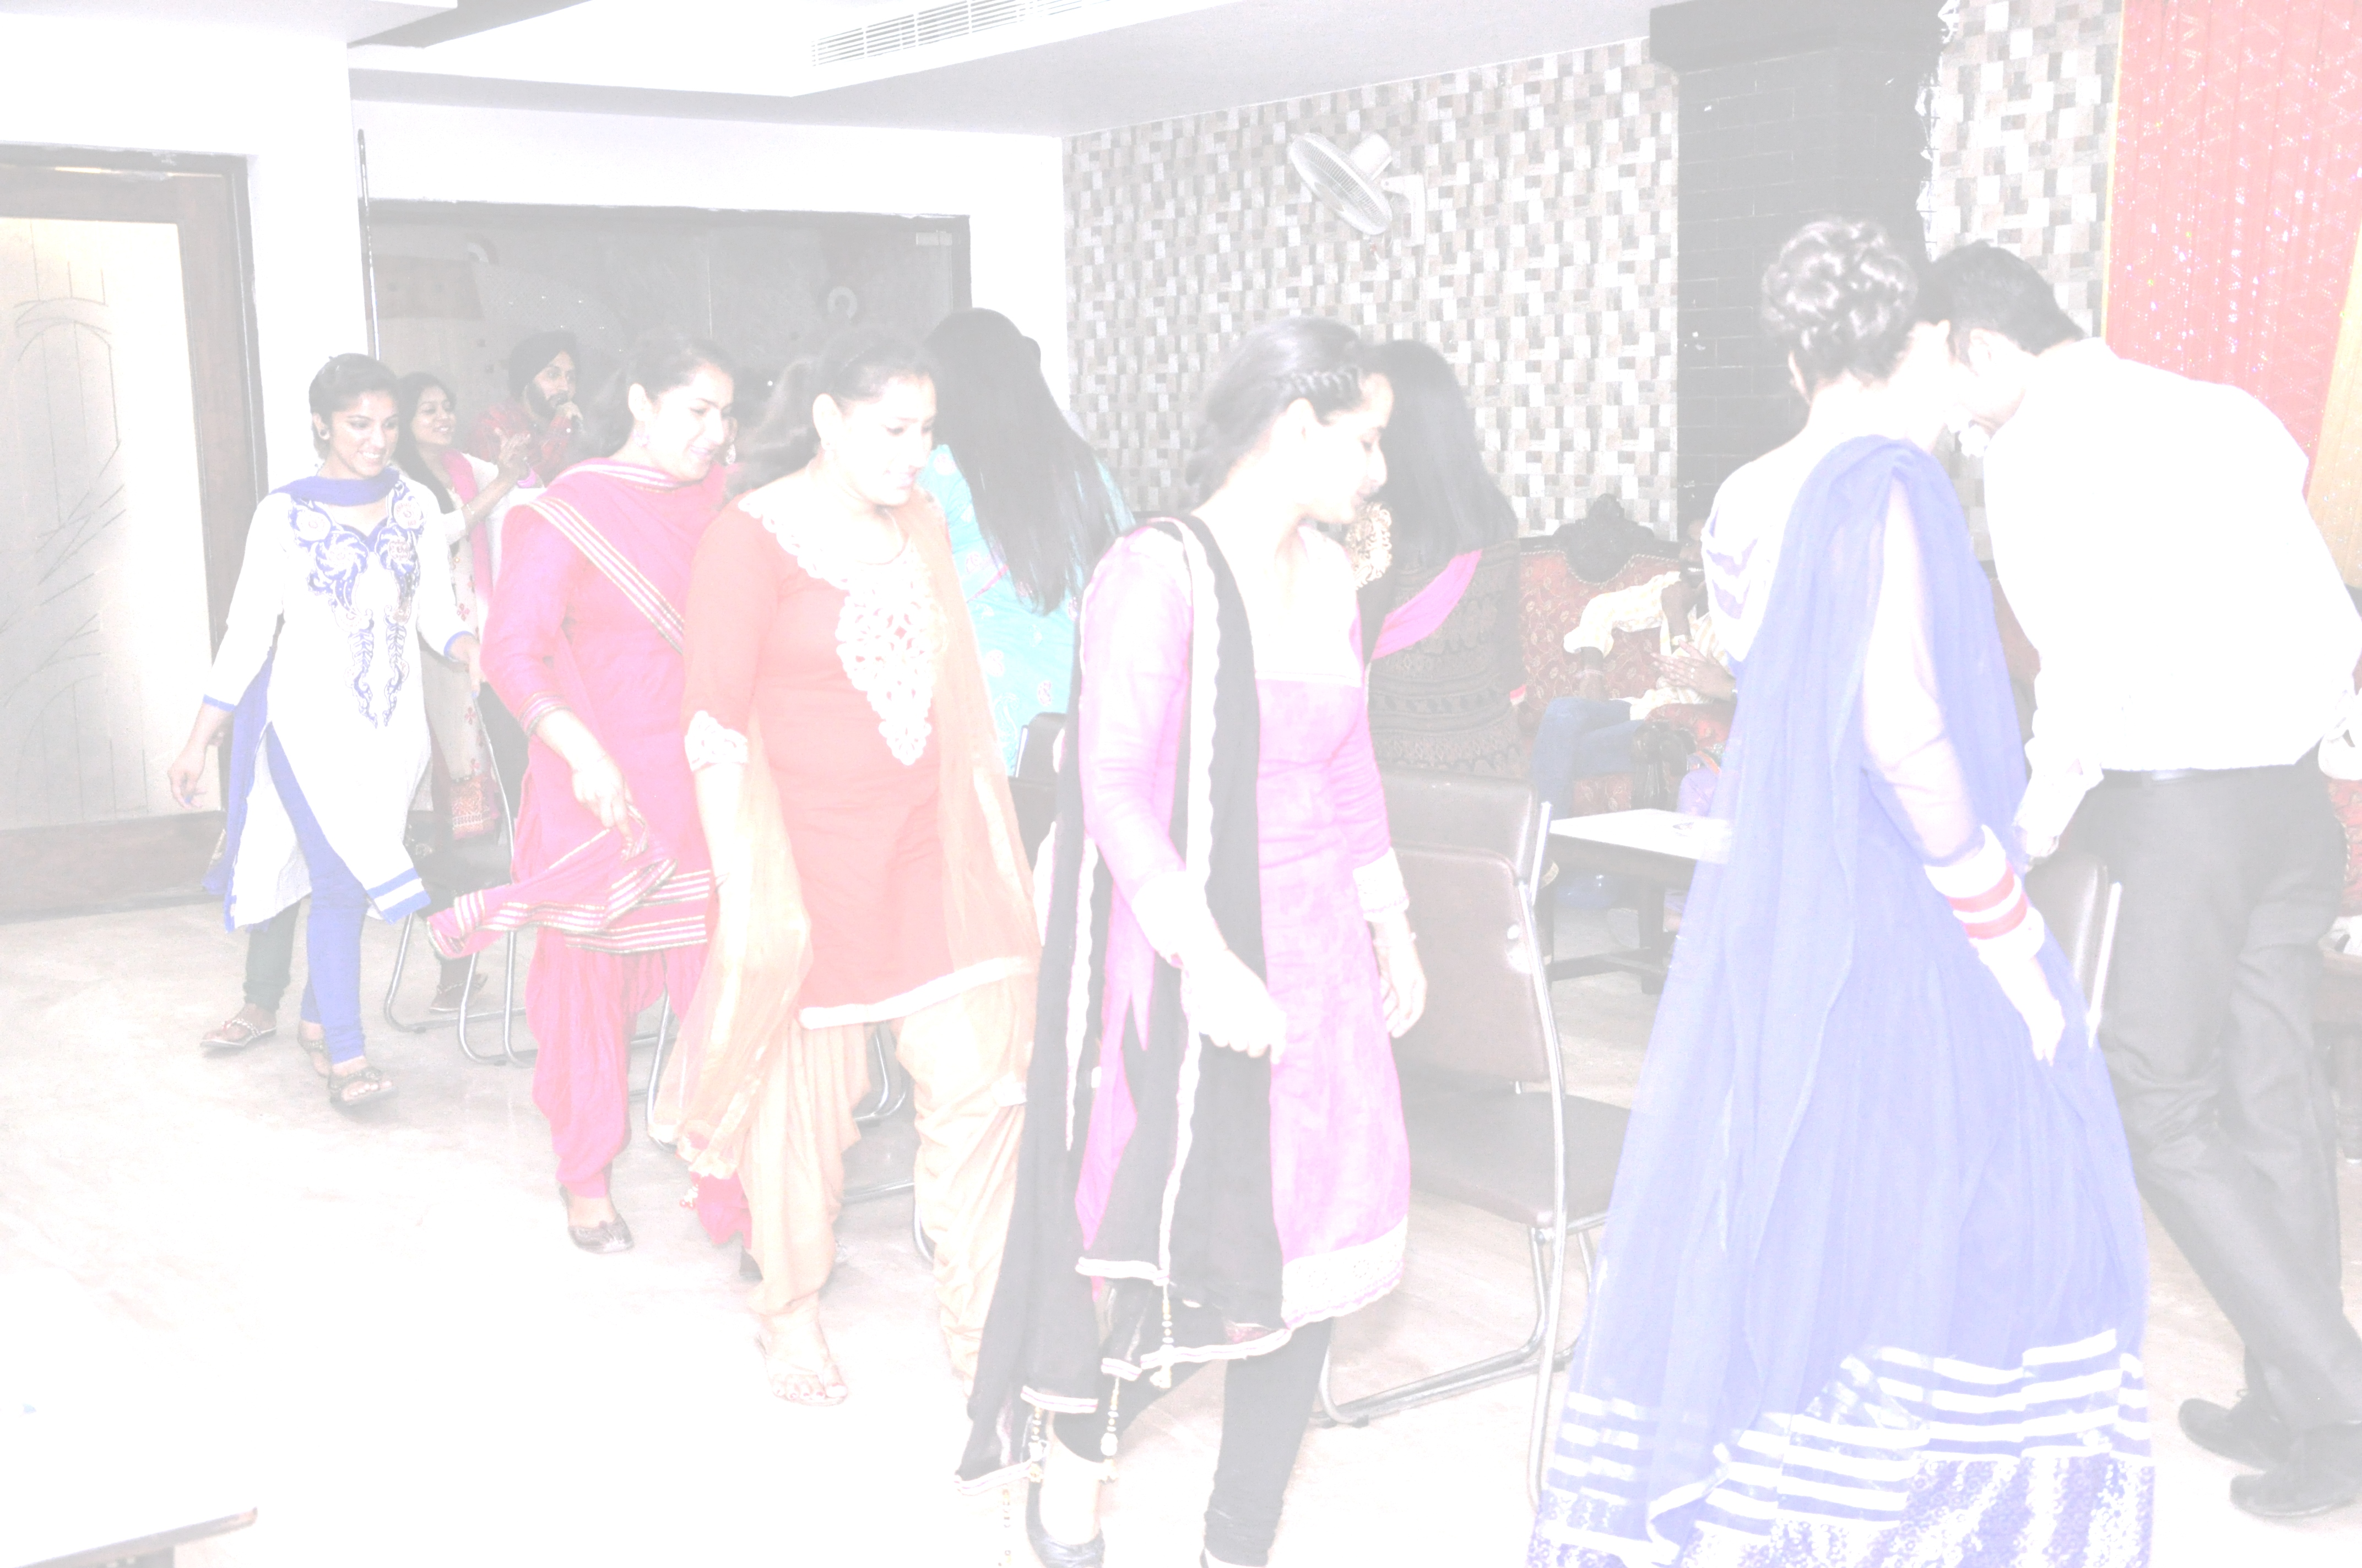
STRENGTH OF STUDENTS
(POST GRADUATION)
CLASSES | NUMBER OF STUDENTS
M.A. I | 36
M.A. II | 20

Slide 13
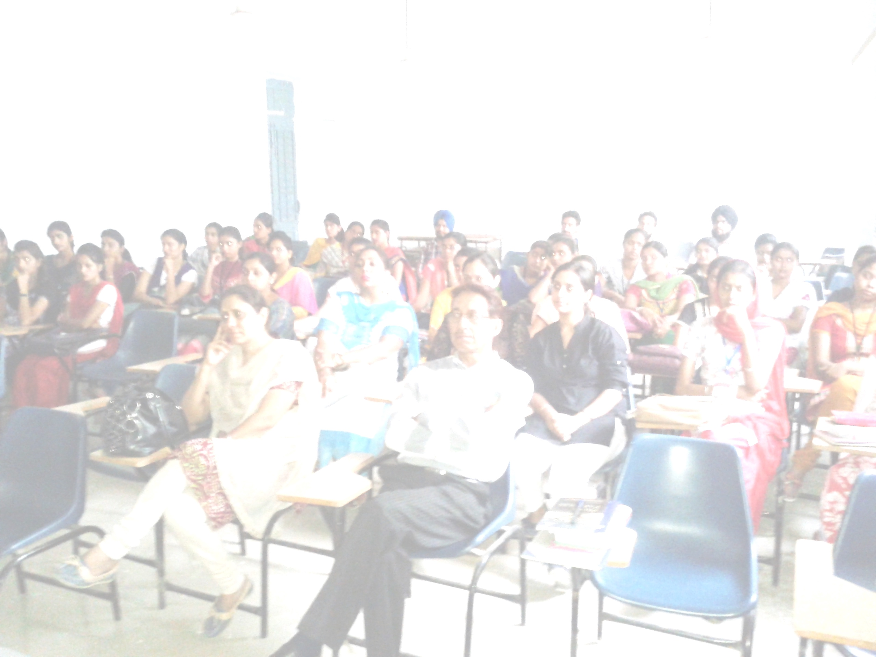
STUDENTS PERFORMANCE EVALUATION
CLASS TESTS
ASSIGNMENTS
MID SEMESTER TESTS(MSTs)
PRESENTATIONS
GROUP DISCUSSIONS
CLASS PARTICIPATION
SEMINARS

Slide 14
ASSESSMENT DIVISION

Slide 15
RESEARCH EXPERIENCE

Slide 16
FEATURES OF THE DEPARTMENT
BOOK RACK
LANGUAGE LAB
FACULTY ROOM
TEACHING AIDS
COMPUTERS

Slide 17
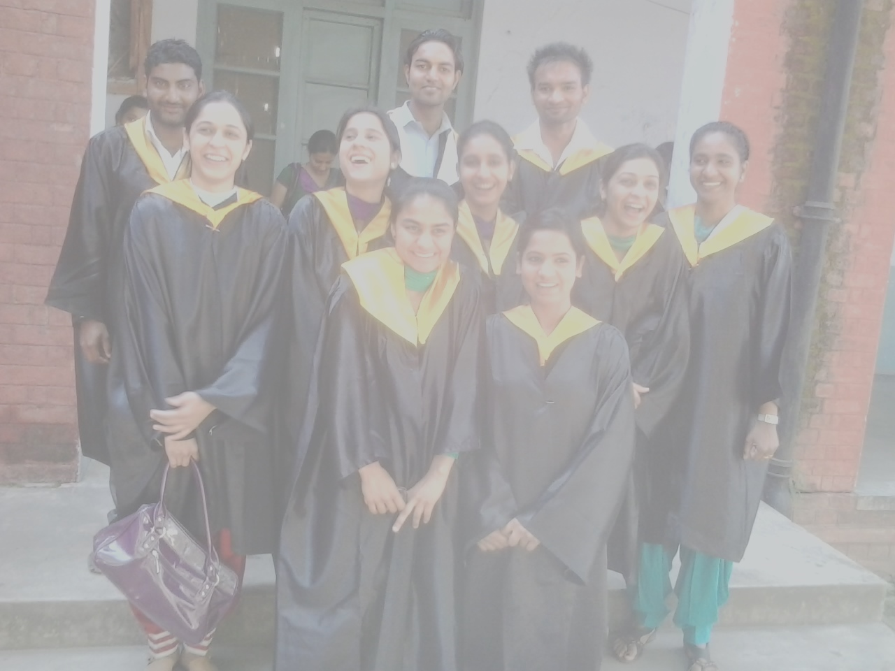
STUDENTS’ SUCCESS RATE (2014-15)

Slide 18
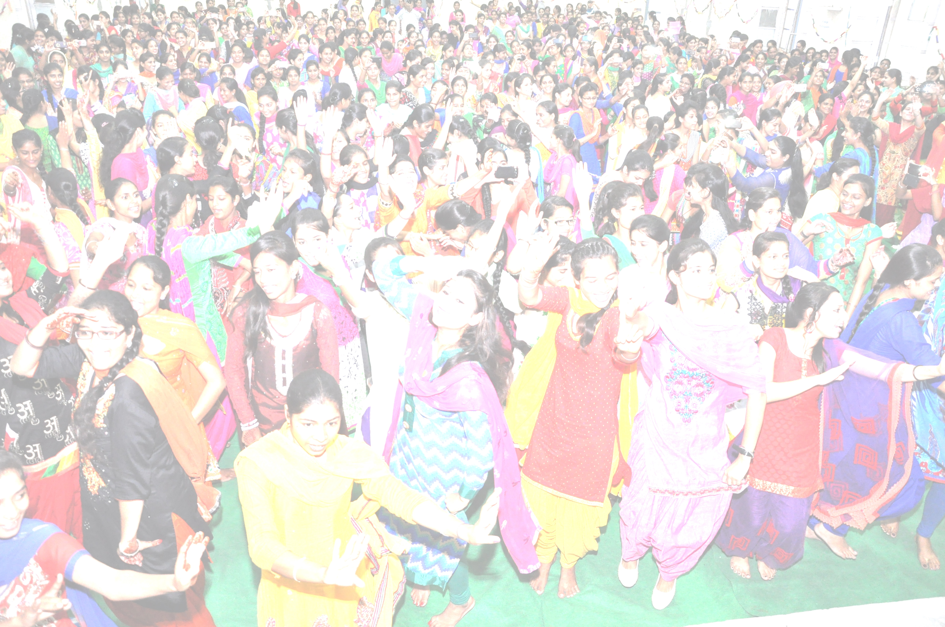
EXTRA CURRICULAR ACTIVITIES
SEMINARS
DISCUSSIONS
MOVIE SCREENINGS
PLAYS
INVOLVEMENT IN NSS, NCC, YOUTH FESTIVALS

Slide 19
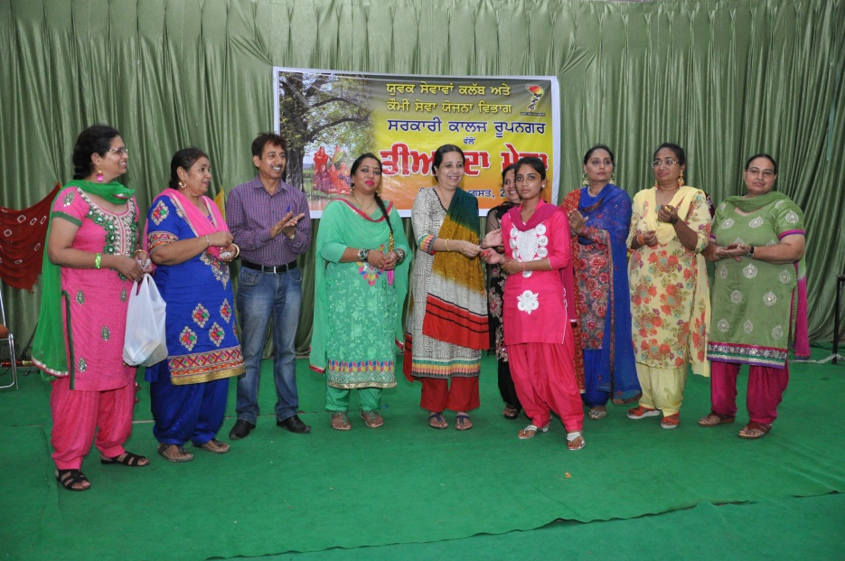
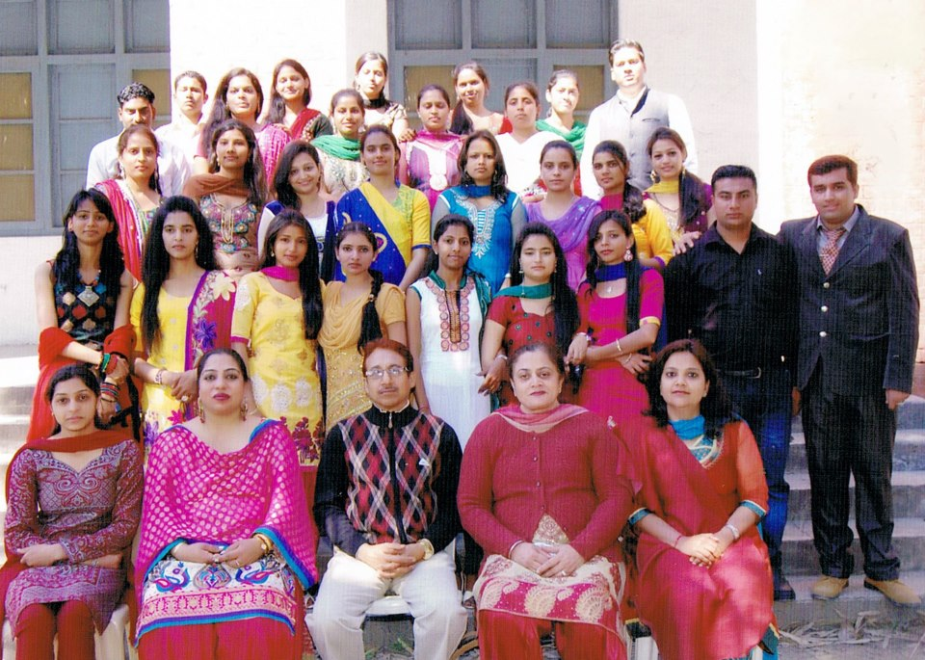
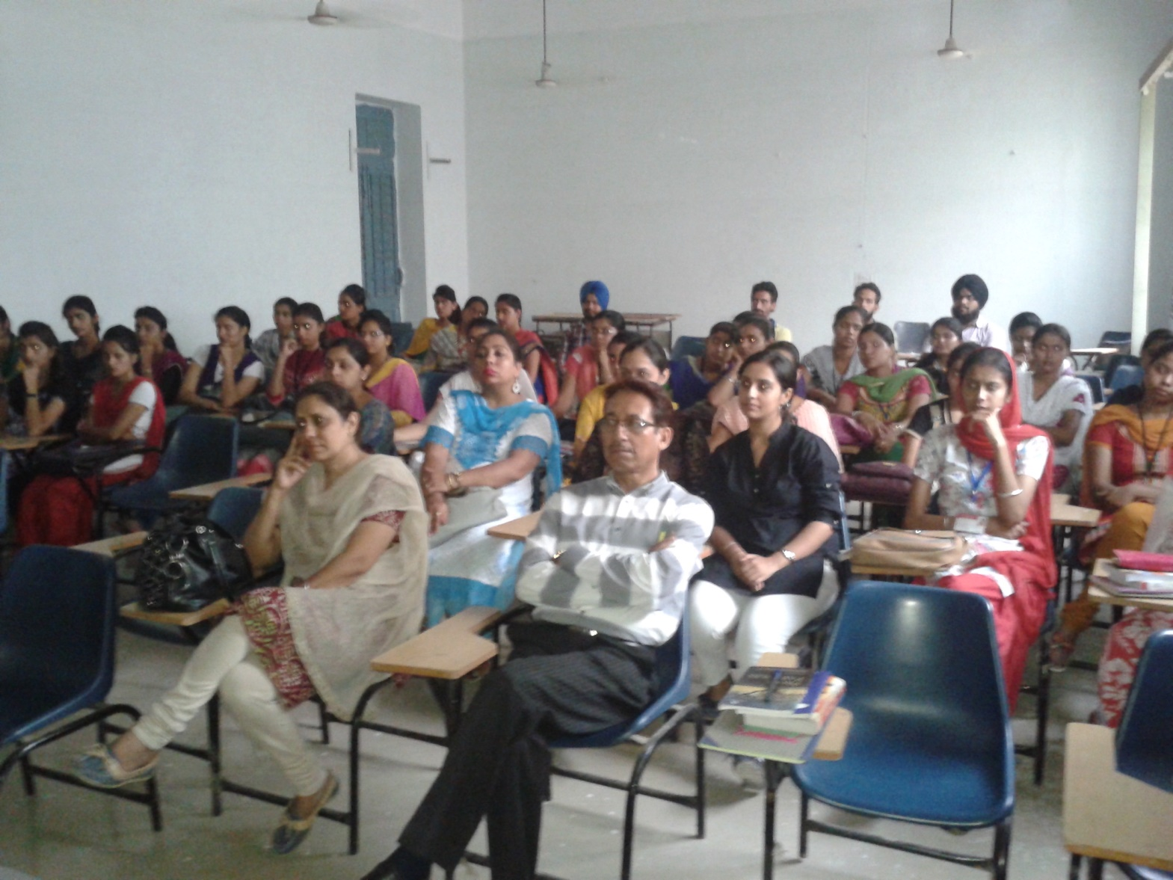
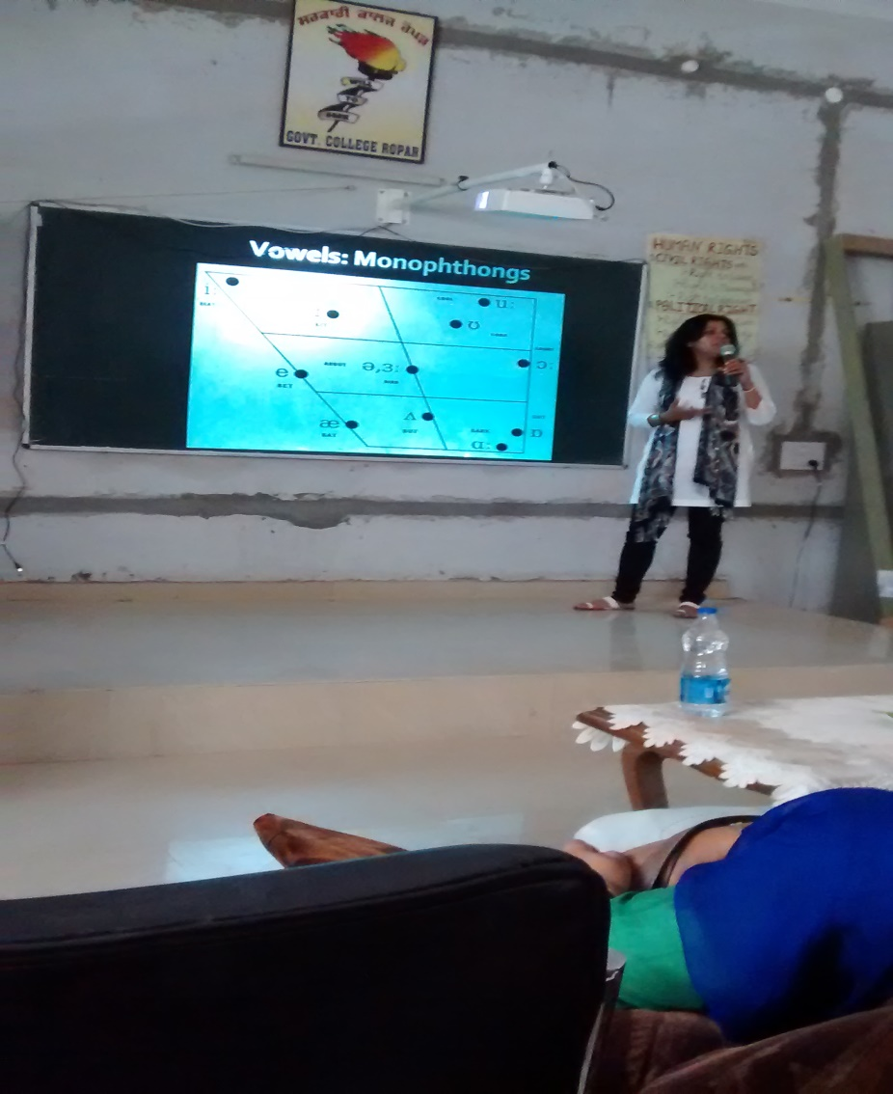

Slide 20
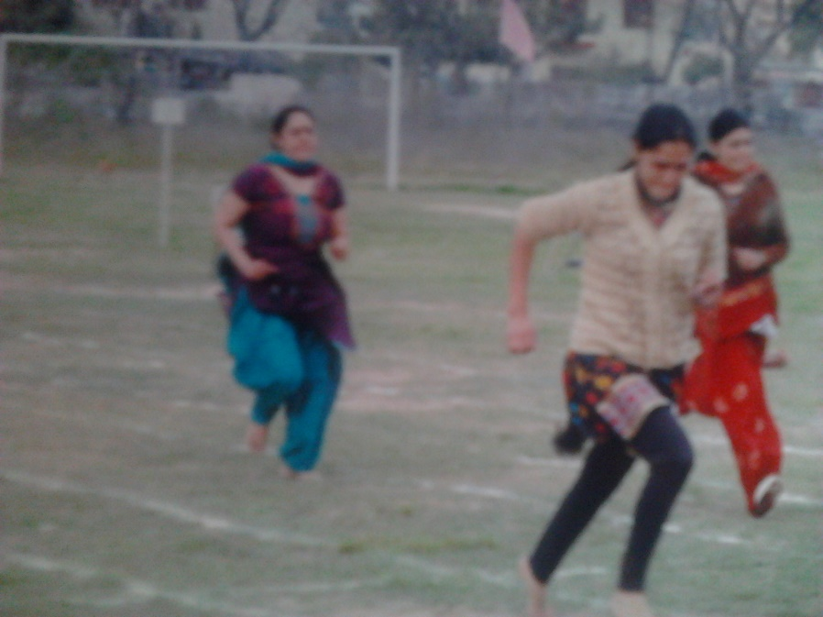
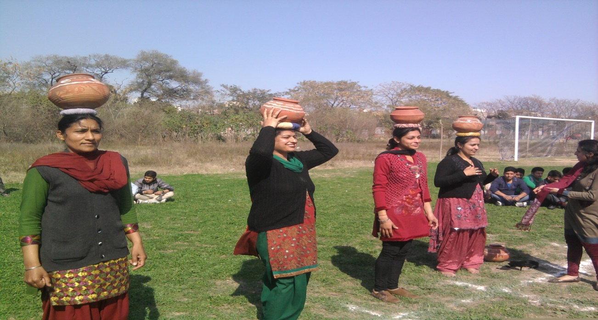
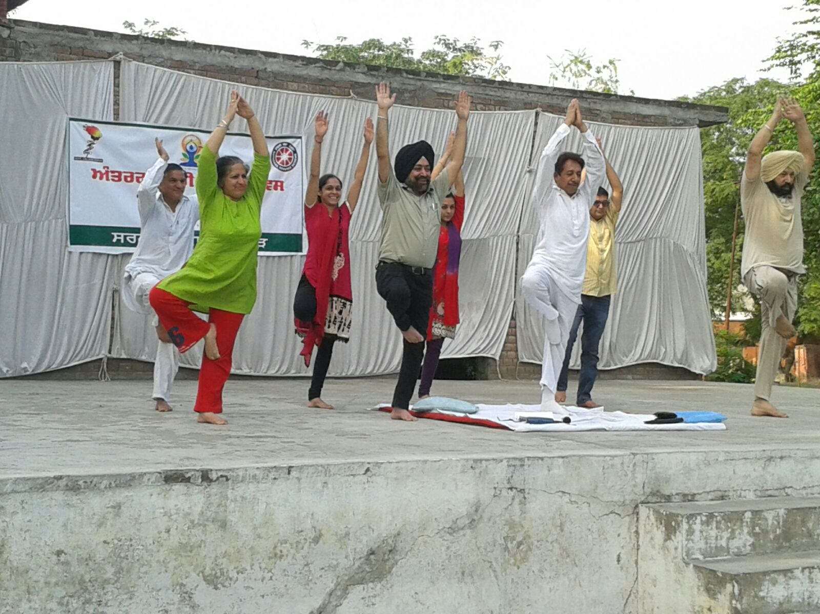
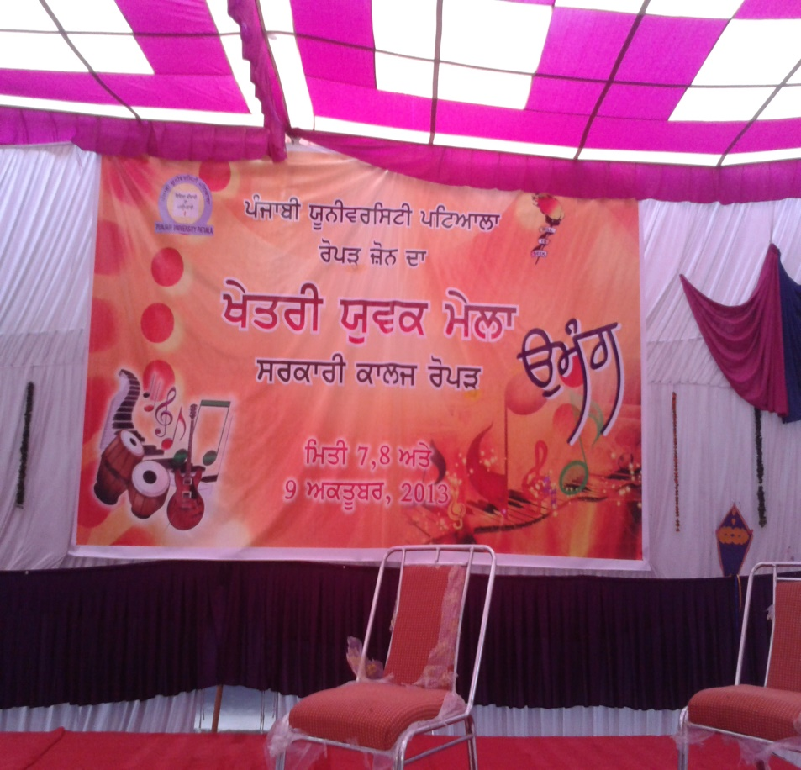

Slide 21
MISSION OF THE DEPARTMENT
To give utmost importance to the socially, economically marginalized sections of students
To preserve and enrich the already rich socio-cultural traditions of the hinterland
To prepare a student such that, when leaving college after completion of the three-year degree course, he/she is equipped with a positive frame of mind, has basic communication skills, should have acquired the ability to explain something logically, and above all, should have developed a balanced personality.

Slide 22




Slide 23
THANK YOU!!

